Slide 1

Contract Monthly Claim System
Streamlining Lecturer Claim Submissions & Approvals
PROG6212 Final Project Presentation
Presented by Naoyuki Christopher Higaki
Notes:
1

Slide 2

Project Overview: What is the CMCS?
Our vision is to create a web-based platform that fully automates the monthly claim process for contract lecturers. This system addresses the inefficiencies of manual, paper-based workflows.
Problem Solved:
The CMCS replaces a cumbersome, error-prone manual process with a digital, efficient, and transparent workflow.
Core Value:
The system saves significant time, drastically reduces administrative errors, and provides full transparency throughout the claims lifecycle.
1
2
3
Lecturers
Programme Coordinators
Academic Managers
Submit claims and track their status in real-time.
Perform first-level review and approval of claims.
Provide final approval and maintain oversight of all claims.
Notes:
2

Slide 3
System Architecture & Technology
The Contract Monthly Claim System is built on a modern and robust technical stack, ensuring reliability and scalability.
Framework
ASP.NET Core MVC provides a powerful foundation for building dynamic web applications.
Language
C# is utilized for its strong typing, performance, and extensive libraries within the .NET ecosystem.
Data Storage
A JSON-based Text File System was implemented to meet a specific project requirement, demonstrating adaptability beyond traditional databases.
Architecture
The Model-View-Controller (MVC) Pattern ensures clear separation of concerns and maintainable code.
Frontend
HTML, CSS (with Grid/Flexbox), and JavaScript deliver a responsive and intuitive user interface.
Authentication
Robust, Session-Based with Role Management provides secure access control tailored to user roles.
Notes:
3

Slide 4
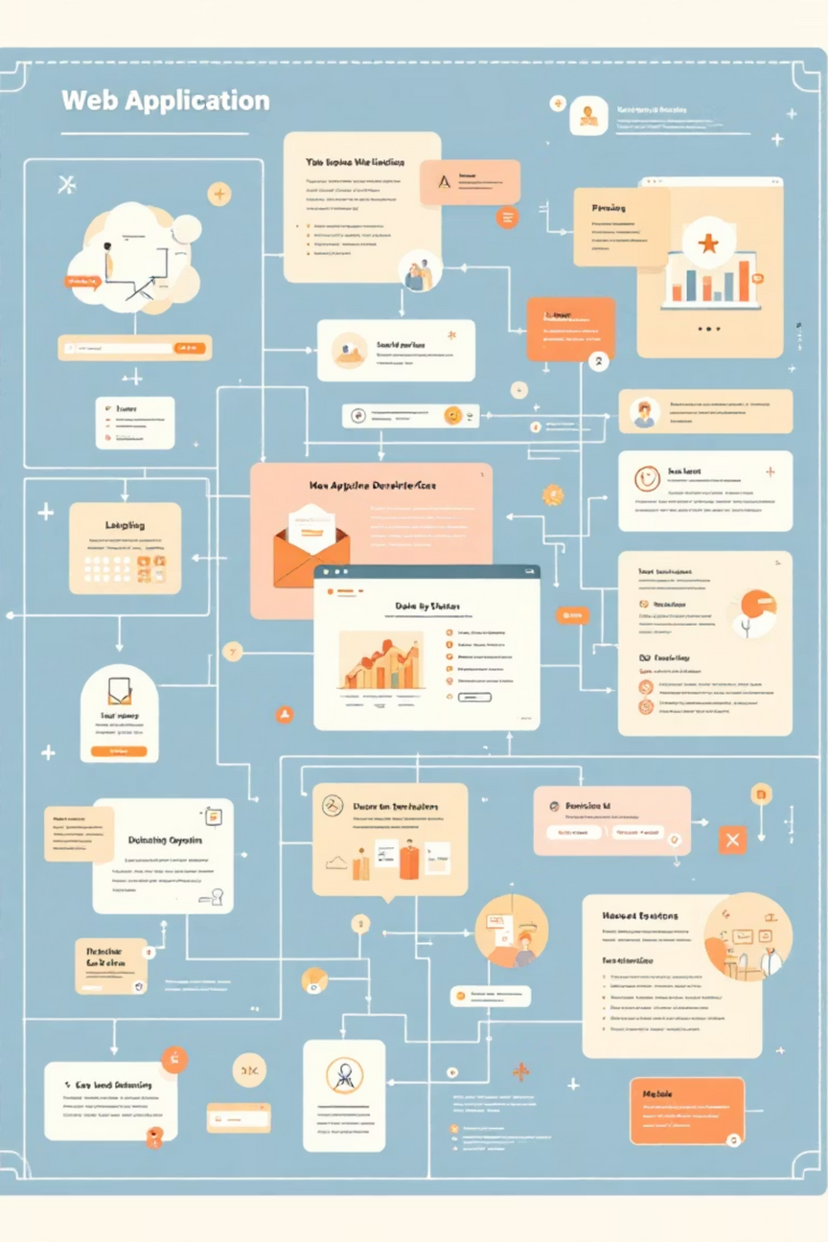

Part 1: Core Prototype (4 Weeks)
Establishing the Foundation
The initial phase focused on building the foundational elements and core functionality of the CMCS.
Weeks 1-2: Requirements & Design
1
Detailed analysis of lecturer and administrative needs.
2
Weeks 3-4: Core Development
Creation of a comprehensive UML Class Diagram to map system components.
Setup of the ASP.NET Core MVC Framework.
Implementation of secure Session Authentication mechanisms.
Initial wireframing and user flow definition.
Development of the basic claim submission and approval workflow.
This phase successfully delivered a functional prototype, demonstrating the essential user journey and validating the system's core concept.
Notes:
4

Slide 5
Part 2: Feedback & Enhancement (3 Weeks)
Addressing Feedback | Grade: 99%
Following the initial prototype, this phase involved critical enhancements based on feedback, refining the system's robustness and user experience.
✅ Database Integration:
✅ Document Upload:
Successfully replaced with a fully functional text-file data layer, demonstrating efficient data handling without a traditional DBMS.
Implemented secure file handling with robust validation for file types and sizes, preventing unauthorized uploads.
✅ UI/UX Refinement:
✅ Error Handling:
The user interface was refined with a minimalist design, focusing on clarity and ease of use.
Comprehensive client-side and server-side validation were added, significantly improving system stability and user feedback.
The result is a robust, high-fidelity application that not only met but exceeded all specified requirements, achieving an outstanding grade of 99%.
Notes:
5

Slide 6




Part 3: The Roadmap (3 Weeks)
Future Development Plan
My future development plan outlines the next steps to evolve the CMCS into a comprehensive and production-ready system.
Week 8: Advanced Features
Develop a Reporting Dashboard for Managers, offering key insights.
Implement Enhanced Data Filtering & Export functionalities.
Integrate an In-App Notification System for timely updates.
Week 9: Security & Performance
Integrate BCrypt Password Hashing for enhanced security.
Optimize File I/O and implement Caching strategies for performance.
Prepare the system for seamless deployment to a live environment.
Week 10: Polish & Deployment
Conduct Comprehensive Testing across all modules.
Finalize all project documentation for future reference.
Execute Production Deployment, making the system live.
Notes:
6

Slide 7
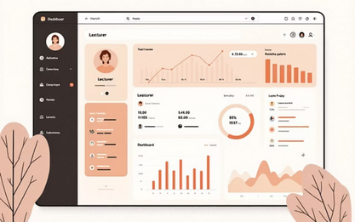
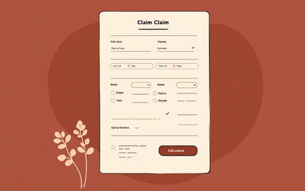
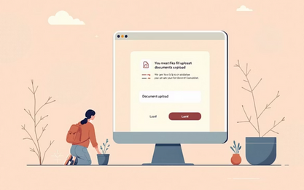
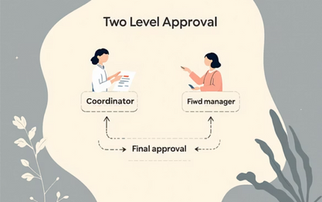


Key Features Demonstrated
A Glimpse of the Application in Action
Role-Based Dashboard
Dynamic Claim Form
Tailored homepages providing relevant information for each user type.
Automated calculation of claim amounts based on hours and rates.
Document Upload
Dual-Level Approval
Secure multiple file uploads with robust type and size validation.
Streamlined workflows for Programme Coordinators and Academic Managers.
Status Tracking
Fully Responsive Design
Clear visual indicators for claim statuses: Pending, Approved, Rejected.
Seamless functionality and optimal viewing experience across all devices.
Notes:
7

Slide 8
Technical Challenges & Solutions
Developing the CMCS presented several technical hurdles, each overcome with innovative and strategic solutions.
Challenge: Text File as a Database
Challenge: Session State Management
Challenge: File Upload Security
A key requirement was to avoid traditional database systems. Our solution involved developing a custom TextFileDataService class.
Maintaining secure and consistent session state across various user roles was complex.
Ensuring the security and integrity of uploaded documents was paramount.
We implemented custom session extensions and rigorous role-based checks, creating a secure and seamless user experience.
Our solution included server-side validation, GUID-based renaming to prevent conflicts, and secure storage outside the web root.
Using JSON serialization for all CRUD operations, we ensured data integrity and efficient persistence without a full DBMS.
Notes:
8

Slide 9
Learning Outcomes & Conclusion
Summary & Reflection on the CMCS Project
This project has been an invaluable learning experience, fostering both technical proficiency and professional growth.
Technical Skills Enhanced:
Professional Growth:
Deepened understanding of the ASP.NET Core MVC lifecycle and its advanced features.
Gained hands-on experience in interpreting diverse user feedback and translating it into functional features.
Mastered the development of custom data persistence layers using non-traditional storage methods.
Developed the ability to adhere to a structured, agile project timeline, managing iterations effectively.
Significantly improved skills in UI/UX design principles and client-side integration techniques.
Enhanced problem-solving abilities when faced with complex technical constraints.
In conclusion, the Contract Monthly Claim System is a successfully delivered, fully-functional, and well-architected web application. It not only proves the core concept but also stands ready for future development and deployment.
Notes:
9

Slide 10

Thank You!
Questions & Discussion
We appreciate your time and attention to my project. We are now open to any questions you may have about the Contract Monthly Claim System.
Thank you for evaluating my final project.
Notes:
10

